Slide 1


Building Web Applications with ASP.NET Core MVC
Session 3: Introduction to ASP.NET Core MVC
05-April-2025
by Syed Ihsaan Abbas Naqvi

Slide 2
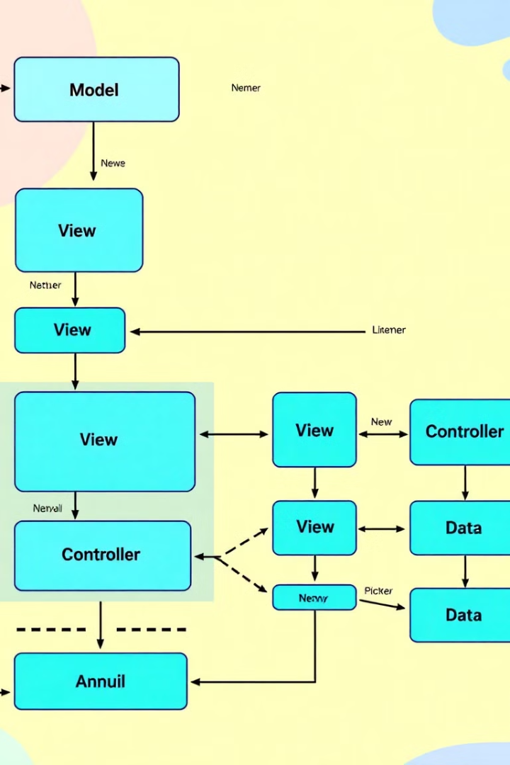
Session Overview
1
MVC Architecture
Framework for building web apps using Model-View-Controller pattern
2
Components
Models, Views, Controllers explained
3
Routing
How requests map to controllers
4
Implementation
Creating a product listing app

Slide 3






ASP.NET Core MVC Architecture
Separation of Concerns
More maintainable code
Dependency Injection
Built-in support
Middleware Pipeline
Request processing

Slide 4
Understanding MVC Components
Model
View
Controller
Application data
UI presentation
Handles input
Business logic
Razor syntax
Application logic
Validation rules
Displays data
Returns views

Slide 5
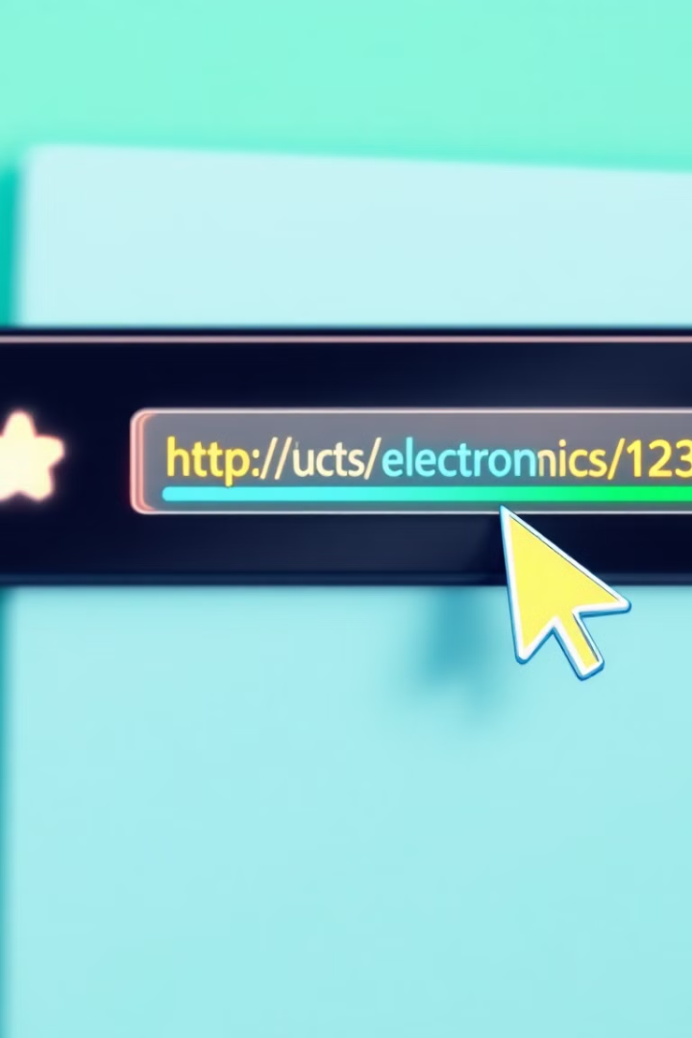



Routing in ASP.NET Core
URL Request
/Product/Details/5
Route Pattern
{controller}/{action}/{id?}
Controller Action
ProductController.Details(5)

Slide 6
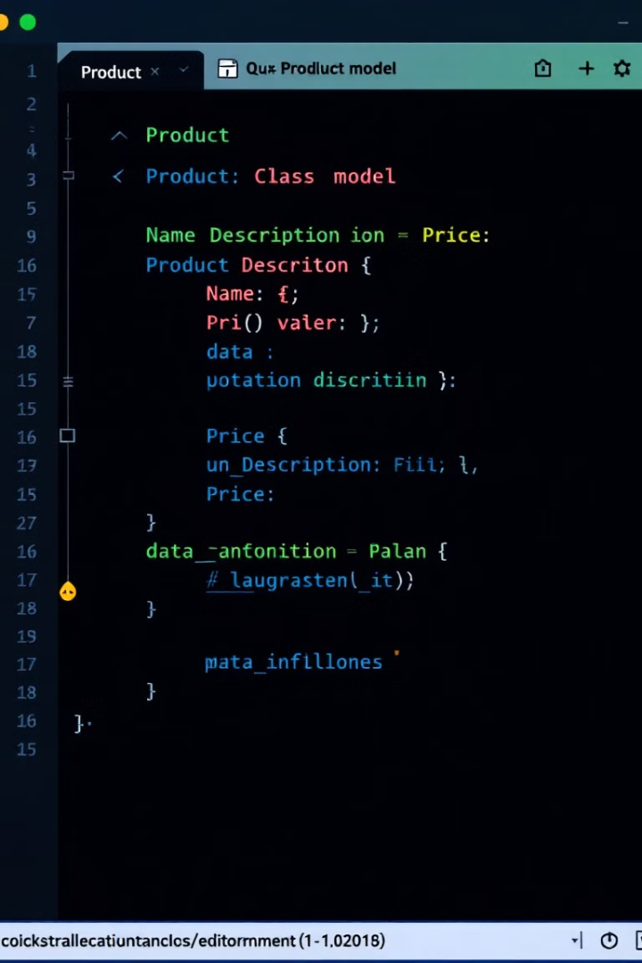
Creating a Model
Define Class
Properties
Create Product class in Models folder
Id, Name, Price
Validation
Add data annotations
public class Product { public int Id { get; set; } public string Name { get; set; } public decimal Price { get; set; } }

Slide 7



Creating Controller and View
Add Controller
ProductController in Controllers folder
Define Action
Index method returns product list
Create View
Index.cshtml displays products

Slide 8
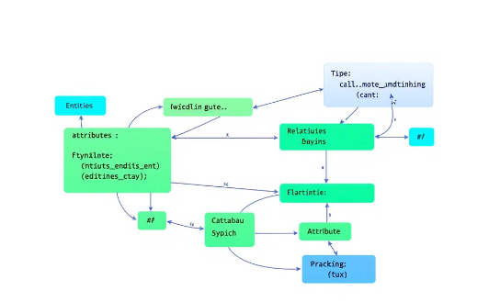


Entity Framework Approaches
Database-First
Code-First
Model-First (Deprecated)
Generate C# models from an existing database schema.
Create the database based on C# classes (models).
Use a visual designer to create the database schema and C# models.

Slide 9








Summary and Next Steps
MVC Architecture
Implementation
Separation of concerns
Basic product listing
Next Steps
Routing
Entity Framework, CRUD operations
URL to controller mapping

Slide 10

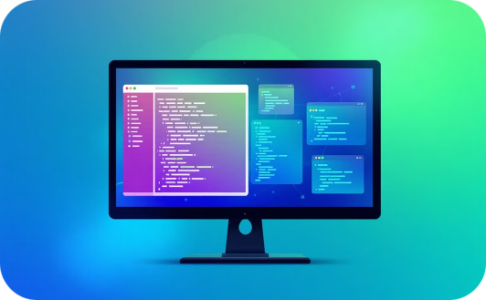

Questions and Answers
How does MVC simplify web app development?
What are the key components of MVC?
How does routing work in ASP.NET Core?
MVC promotes separation of concerns, leading to more maintainable code.
Models, Views, and Controllers each handle specific aspects of the application.
Routing maps URL requests to specific controller actions.
Feel free to ask any additional questions!

Slide 11



Thank You
Appreciation
Teamwork
Gratitude
We value your attention and engagement.
Grateful for the opportunity to collaborate and share our insights.
Thank you for the time and support.
We extend our sincere gratitude for your time, attention, and support throughout this presentation. We hope that the information shared was valuable and insightful.

